Slide 1
Pixel 3 GMS App Investigations
Part 4: Google Photos
Notes:
https://digitalcorpora.s3.amazonaws.com/corpora/mobile/android_10/Non-Cellebrite%20Extraction/Pixel%203.zip

Slide 2
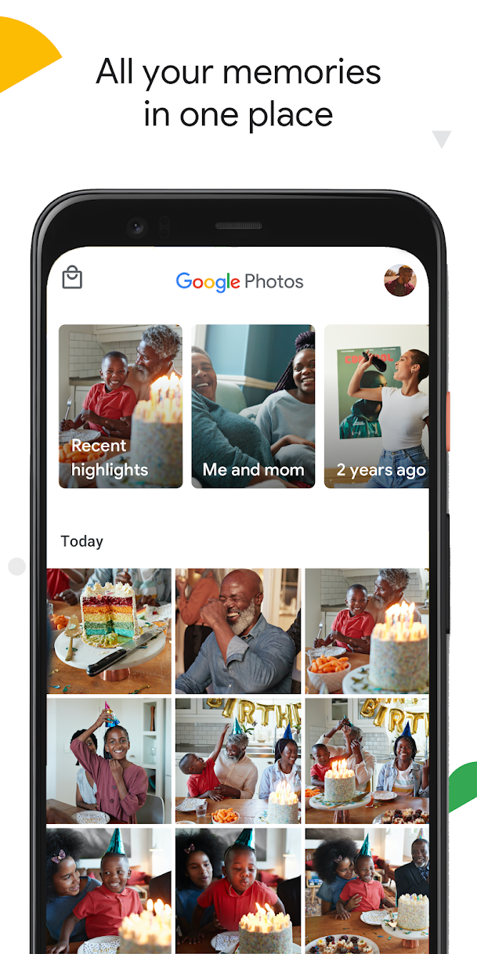
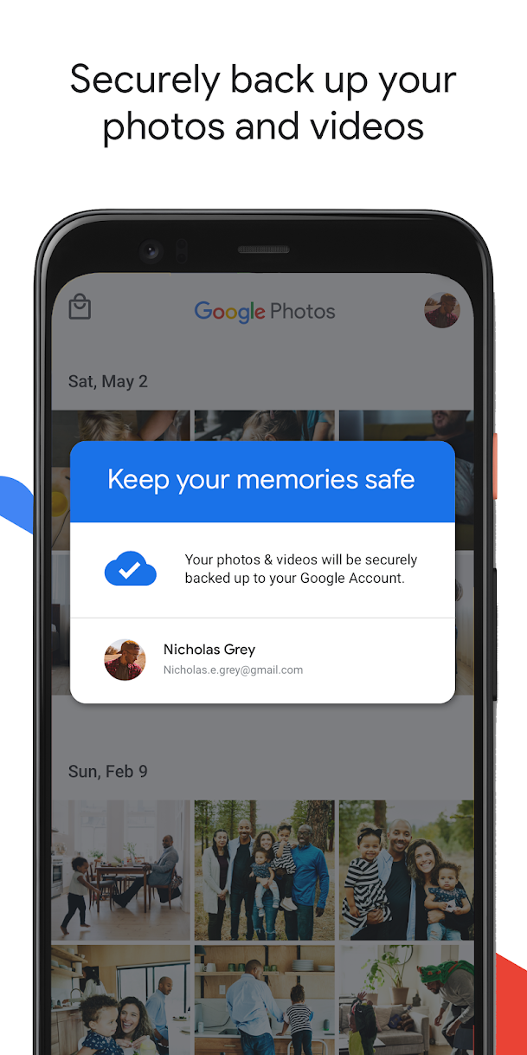
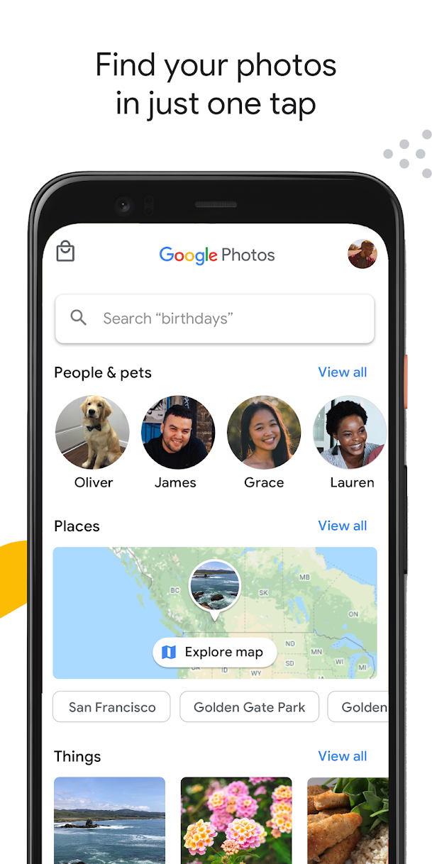
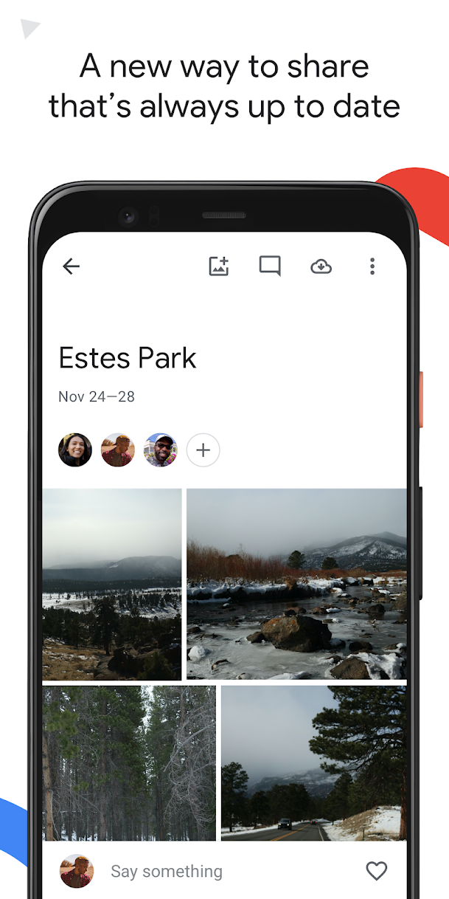
What is Google Photos ?
a cloud-based photo and video storage and sharing service

Slide 3
Google Photos functions
Cloud Storage
Automatic Backup and Sync
Search and Organization
Advanced editing suite
Shared albums
Memories and Creation
Face and Object Recognition
Cross-Platform Availability

Slide 4
How to know if backup is enabled?
Any photos that you take from a device with backup enabled will be saved to your Google Account.
If you edit and save a photo on your phone, the photo will look the same on Google Photos
Shared Preferences is the folder where such information gets stored.
Allow activities and applications to keep preferences.
Store user-specified configuration details, such as user-specific settings, keeping the user logged into the application

Slide 5
Why it's important to look for back up?
Backup is crucial in an investigation because:
Suspect may have deleted data related to the case but took back up before deleting
If the system crashes, data can be recovered quickly from backup
Backup is done to save something important
Timestamps of the backup can be useful

Slide 6
Some forensic questions related to photos
What photos are saved? location and timestamps
What location has the most photos?
Did a suspect receive the photos from someone, or were they clicked using the phone?
Can we deduce the suspect's relation to people in the photos/videos?
Are there any deleted photos?

Slide 7
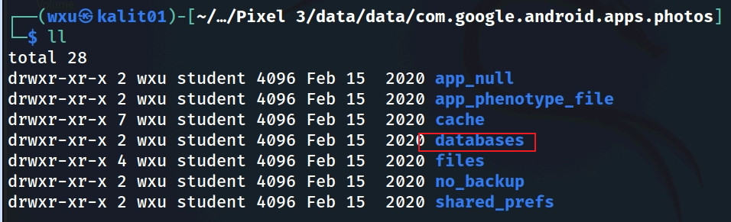
Find the database where photos are stored
Show Google Photos package structure
Notes:
Cmd: tree 'Pixel 3/data/data/com.google.android.apps.photos' -L 1

Slide 8
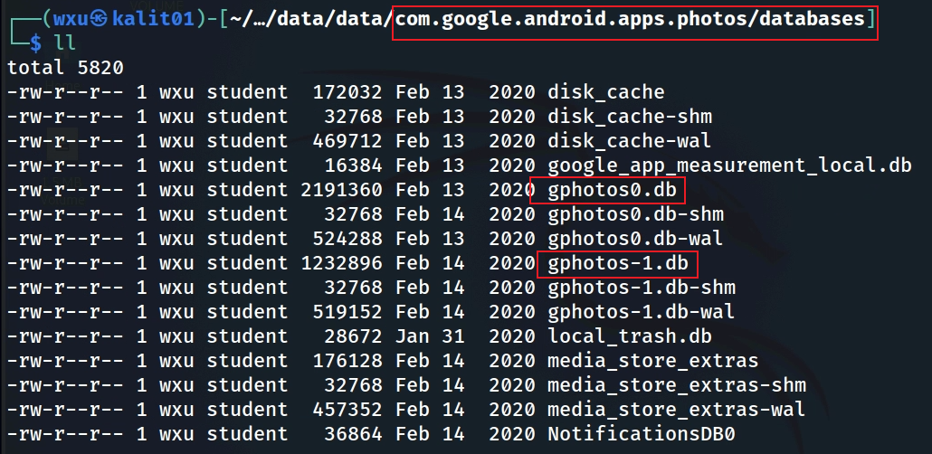
gphotesx.db in Photo databases
Notes:
Cmd: tree 'Pixel 3/data/data/com.google.android.apps.photos/databases'

Slide 9
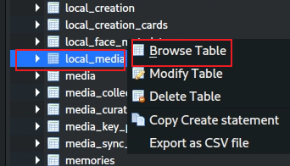
Find one table in gphotos-1.db containing photos
Local_media table contains photos
You can explore other tables as well based on what information you need
Notes:
Cmd: sqlitebrowser 'Pixel 3/data/data/com.google.android.apps.photos/databases/gphotos-1.db'

Slide 10
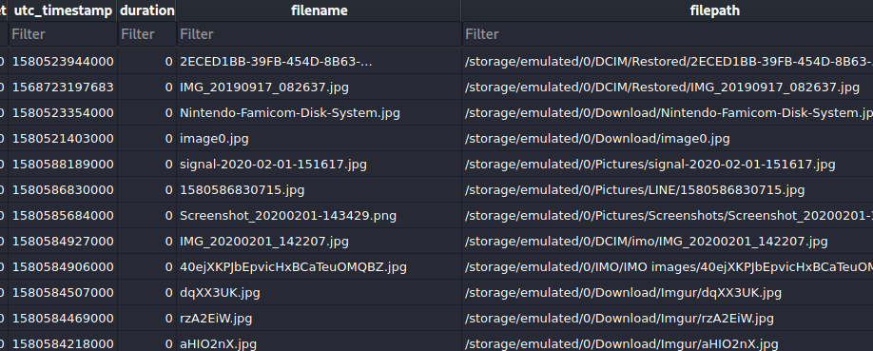
Find one sample picture

Slide 11
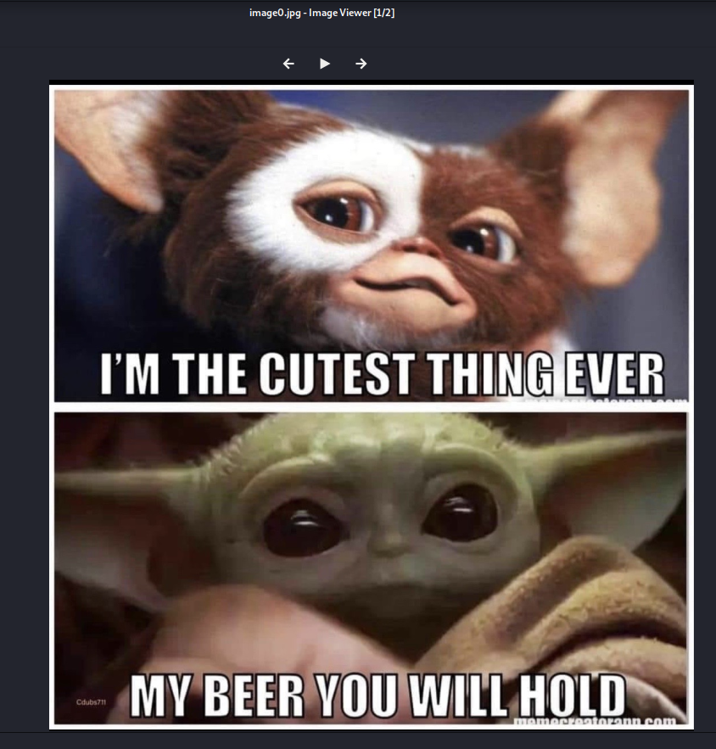
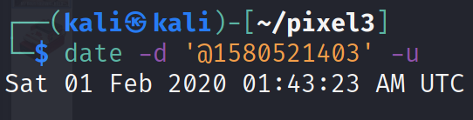
Solution (download images)
Image0.jpg
Date when image was clicked

Slide 12
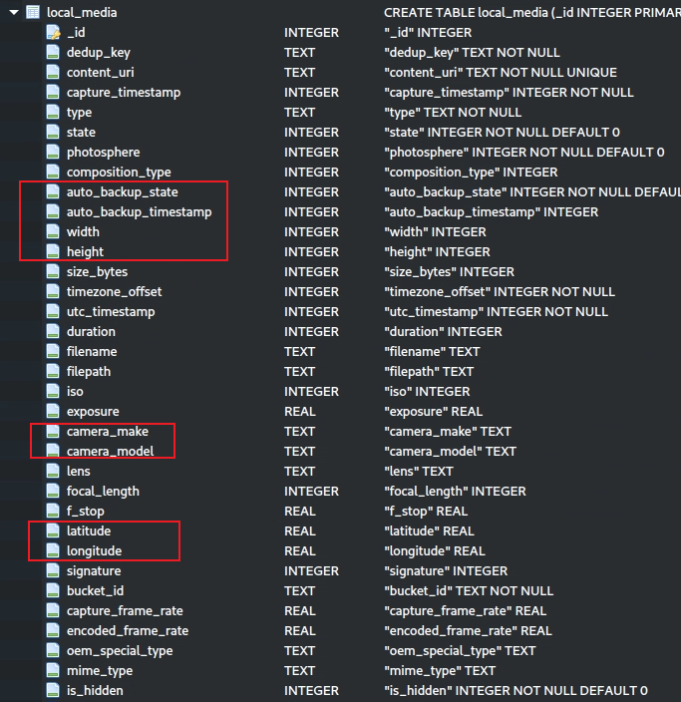
Attributes of local_media table

Slide 13
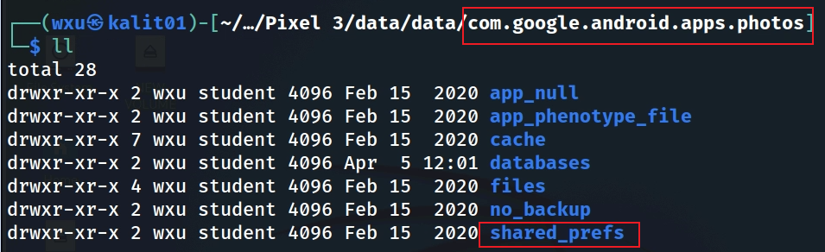
When was the last backup completed?

Slide 14
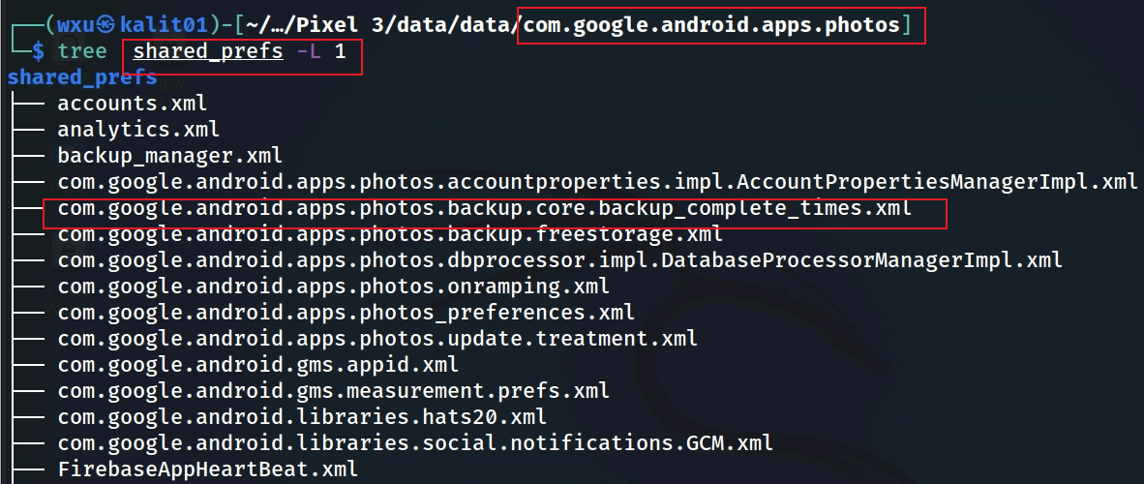
Show files related to shared_prefs
Notes:
Cmd: tree 'Pixel 3/data/data/com.google.android.apps.photos/shared_prefs' -L 1

Slide 15
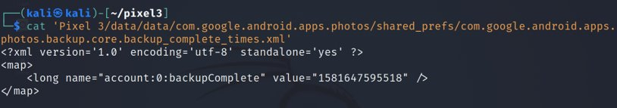
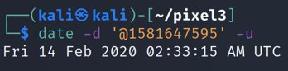
Open the file
This is the time when the account back up was done
Solution: timestamp
Notes:
Cmd: cat 'Pixel 3/data/data/com.google.android.apps.photos/shared_prefs/com.google.android.apps.photos.backup.core.backup_complete_times.xml'
Date cmd: date –d '@1581647595' -u

Slide 16
Assignment
Can you answer the rest of the questions?

Slide 17
To summarize
Understand the application
Locate the application package
Look at the application directories
Go to the databases directory
Open gphotos-1.db
Explore local_media table
Go to the shared prefs folder
Find the the file that contains back up information

